Slide 1
S-101 Test Dataset Production Task
Edward Kuwalek
Sep 22th, 2015

Slide 2
Key Objectives
Tasked by NOAA to develop S-101 test datasets to support testing of various S-101 data loading scenarios
Create ISO 19115 Metadata records for each S-101 test dataset
Create S-101 exchange catalogue
Develop XML schema for S-101 Exchange Catalogue

Slide 3
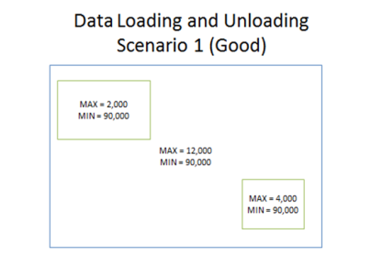
S-101 Test Dataset Production
Content of test datasets prescribed in task SOW and based on test case scenarios for S-101 data loading
Initially created as S-57 ENC datasets
Converted to S-101 using S-101 Converter and S-101_FC_0.8.9.xml
Total of 21 datasets produced

Slide 4
S-101 – ISO 19115 – Metadata Capture
S-101 metadata template was developed based on recent S-100 modeling work
Metadata elements were extracted from S-57 source datasets and used to manually populate metadata records for individual datasets
Currently this is a labour intensive work which will be automated as production tools mature

Slide 5
S-101 Exchange Catalogue Capture
S-101 preliminary exchange catalogue schema was developed based on recent S-100 modeling work
Exchange catalogue metadata elements were extracted from S-57 and S-101 datasets and used to manually populate exchange catalogue records
Currently this is a labour intensive work which will likely be automated as production tools mature
All elements in place to create S-101 exchange set

Slide 6
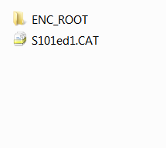
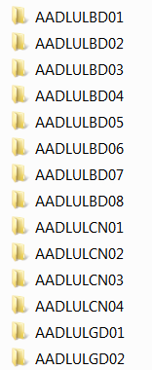
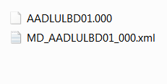
S-101 Exchange Set

Slide 7
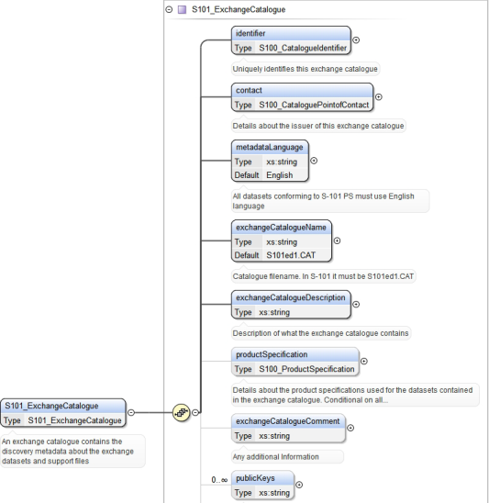
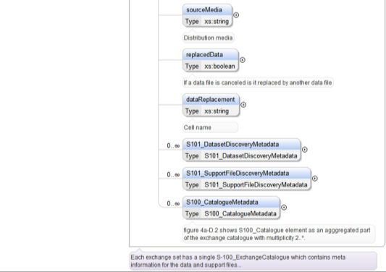
S-101 Exchange Catalogue

Slide 8
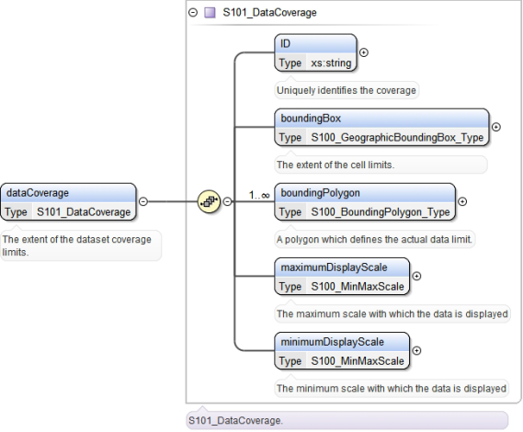
S-101 Exchange Catalogue
Questions?

Slide 9
Items for Consideration
There are still some inconsistencies between S-100 Ver 2.0 and S-101 Product Spec (2015/07/22) – it is recommended to consolidate/adjust them accordingly to support interoperability and streamline maintenance of product specifications
Outputting 19115 metadata or S-101 exchange catalogues was outside of S-101 Converter scope - this could be a desirable functionality
Schemas to be published by IHO at http://www.iho.int/s100/xc and S100XC used as XML namespace

Slide 10
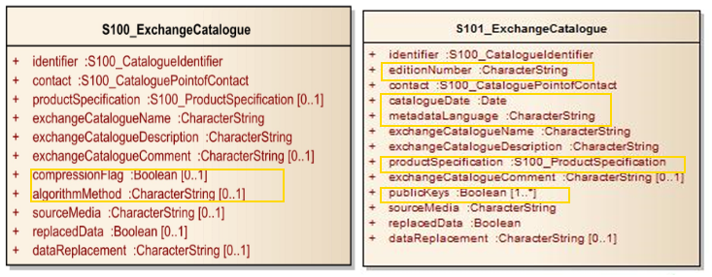
Items for Consideration

Slide 11
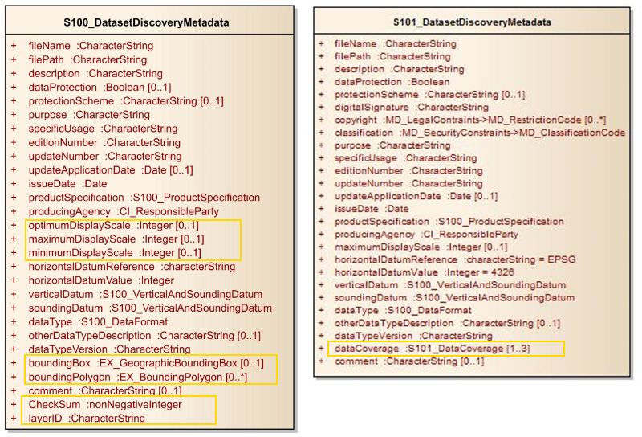
Items for Consideration

Slide 12
Items for Consideration
S-101 Converter reports 3 types of warnings related to either items currently not in FC or not explicitly in product specification (i.e. CATCOV) – this should probably be addressed mostly at FC level
Can't find attribute CATCOV(18) for DataCoverage
Can't find attribute CSCALE(80) for DataCoverage
Can't find attribute EXPSOU(93) for Sounding
Can't find attribute PEREND(118) for BuoyLateral
Can't find attribute PEREND(118) for LightAllAround
Can't find attribute PERSTA(119) for BuoyLateral
Can't find attribute PERSTA(119) for LightAllAround
Can't find attribute SCAMIN(133) for Coastline

Slide 13
Items for Consideration
Can't bind information type SupplementaryInformation to BeaconLateral
Can't bind information type SupplementaryInformation to BeaconSpecialPurposeGeneral
Can't bind information type SupplementaryInformation to BuoyLateral
Can't bind information type SupplementaryInformation to BuoySafeWater
Can't bind information type SupplementaryInformation to Coastline
Can't bind information type SupplementaryInformation to Daymark
Can't bind information type SupplementaryInformation to Fairway
Can't bind information type SupplementaryInformation to FogSignal
Can't bind information type SupplementaryInformation to ShorelineConstruction

Slide 14
Questions?

